Slide 1
Hand Gesture Recognition
Computer Vision Project
Dylan Dominguez and Rida Sohail

Slide 2
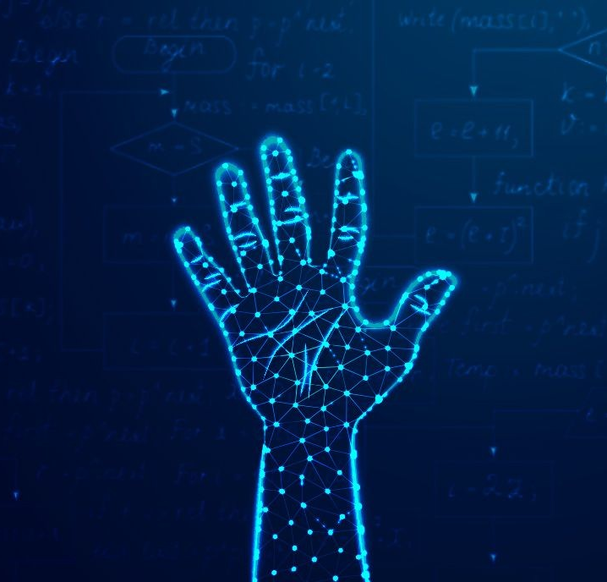
Introduction
Primary Goal:
Hand Gesture Recognition System
Desired Goal:
Virtual Calculator Application
Moonshot:
Sign Language Recognition

Slide 3
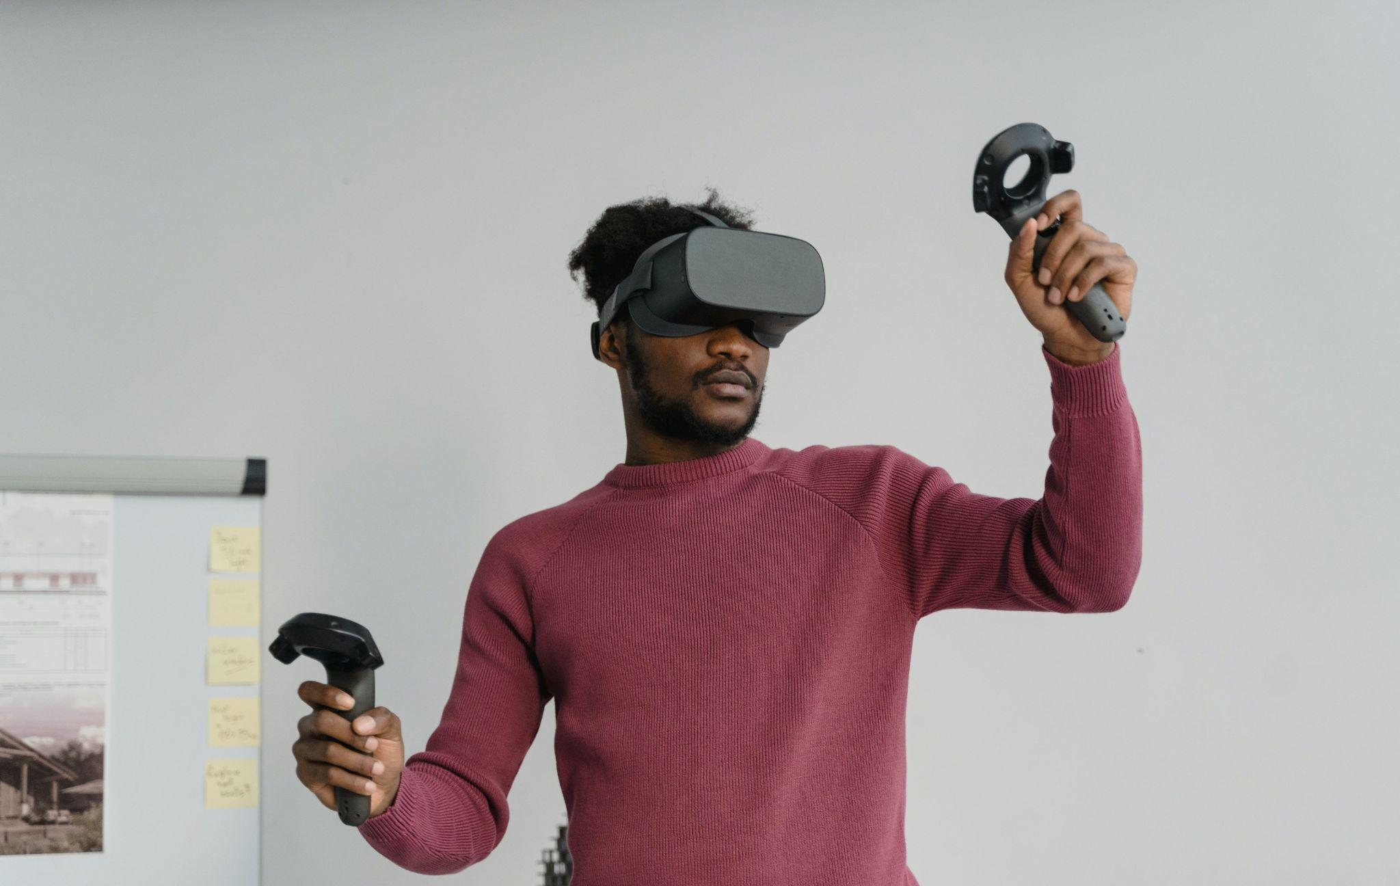
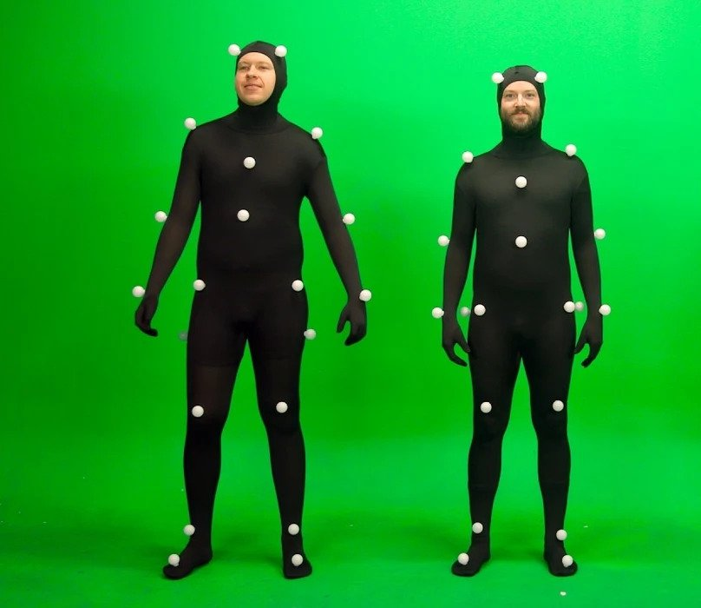
Benefits of Gesture Tracking

Slide 4
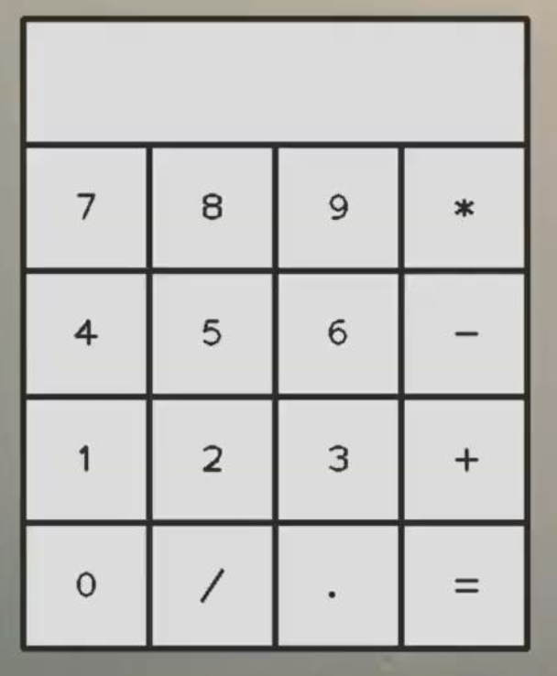
Project Overview
What is Hand Gesture Tracking?
The Technologies We've Chosen: MediaPipe and OpenCV
Calculator Interface using CV, hand landmark mode for detection using MediaPipe

Slide 5
Mathematical Approach in MediaPipe Hand Landmark Model
Convolutional Neural Networks (CNNs):
processing structured grid data such as images
capturing spatial hierarchies and patterns
KeyPoint Regression:
identify and locate key points (landmarks) on the hand
model predicts the coordinates of these keypoints
Hand Pose Estimation:
the spatial orientation and configuration of the hand in three-dimensional space
understand the position of individual landmarks and also the overall pose and orientation of the hand
Normalized Coordinates:
scaling and translating the coordinates of landmarks to a common reference frame
aids in making the model invariant to variations in hand size and position
Loss Functions:
the model optimizes its parameters by minimizing a defined loss function
quantify the difference between the predicted and actual coordinates of the hand landmarks
Data Augmentation:
for generalization including random rotations, scaling, and translations applied to the input data during training

Slide 6
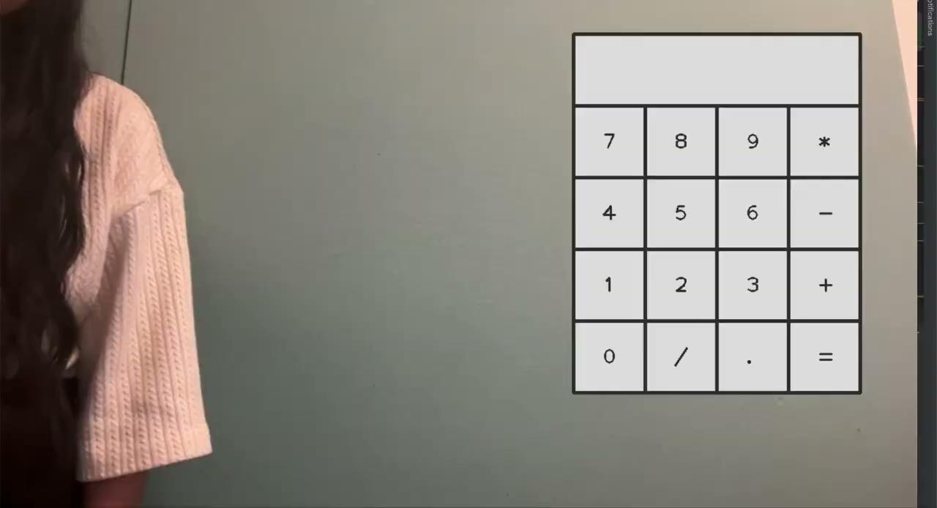
Integrating Hand Gesture Recognition into the Calculator App

Slide 7
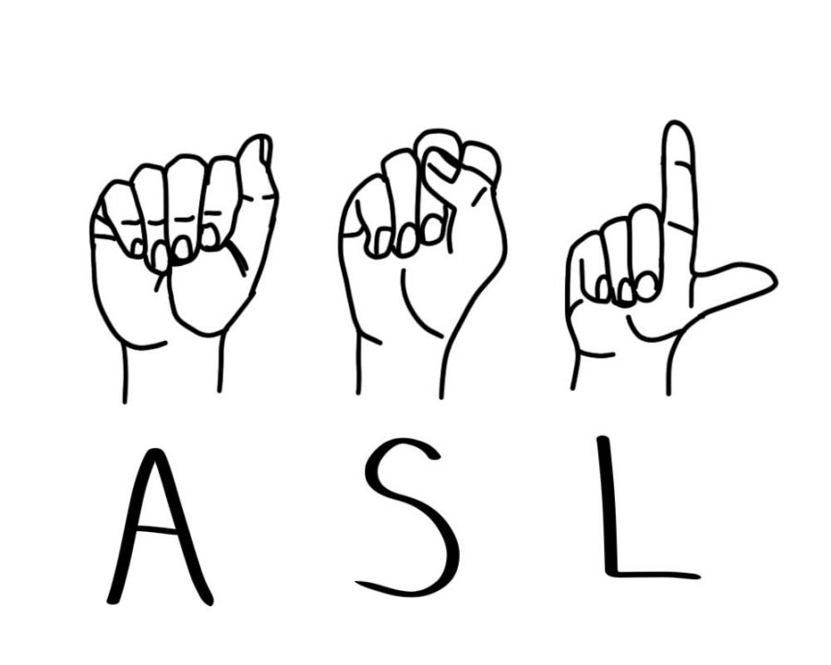
American Sign Language Alphabet Detection
ASL is widely used in the U.S., ranking as the third most common language.
This application focuses on bridging the communication gap in healthcare between ASL users and others.
We're leveraging computer vision and machine learning to enhance interaction and accessibility.
There are various methods to ASL detection
Computer Vision
Mediapipe (landmarks)
Traditional machine learning algorithms
Deep learning
Sensor-based Methods

Slide 8
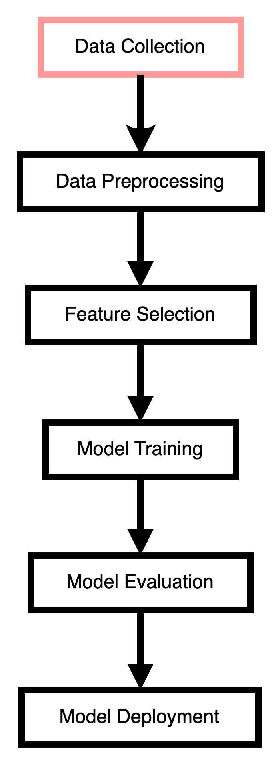
Data Collection and Preprocessing for ASL Recognition
Effective ASL recognition hinges on the quality and quantity of the dataset.
Challenges include:
Distinguishing between right and left hands
Determining hand distance from the screen
Tracking hand location on the screen.
Quality of image
Datasets
Kaggle: o https://www.kaggle.com/datasets/grassknoted/asl-alphabet
29 letters and signs * 3k frames = 87,000
Created my own dataset
24 letters * 500 frames = 12,000

Slide 9
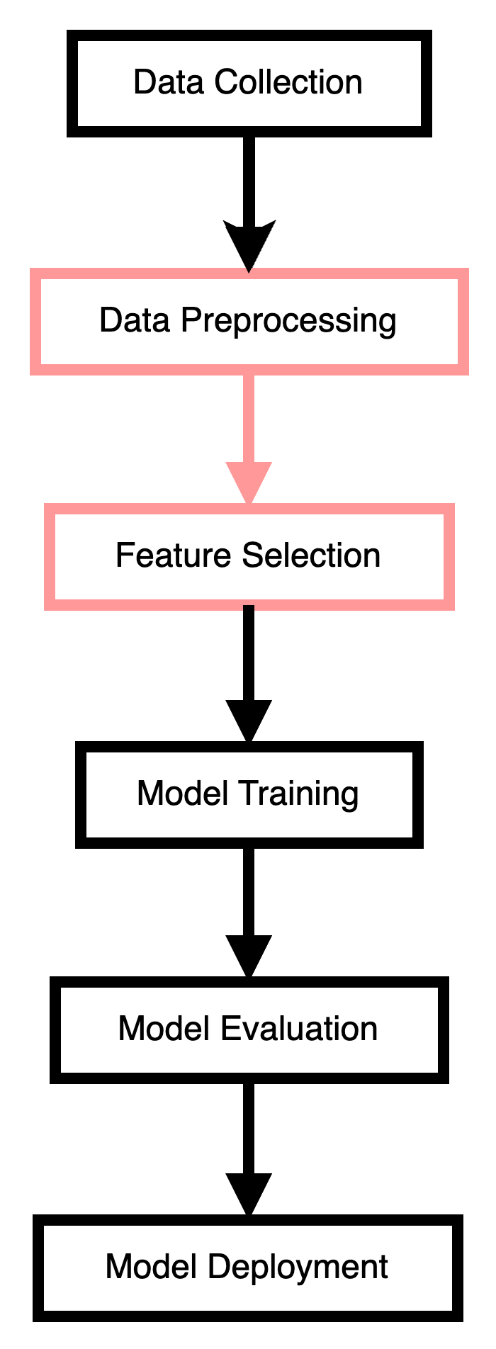
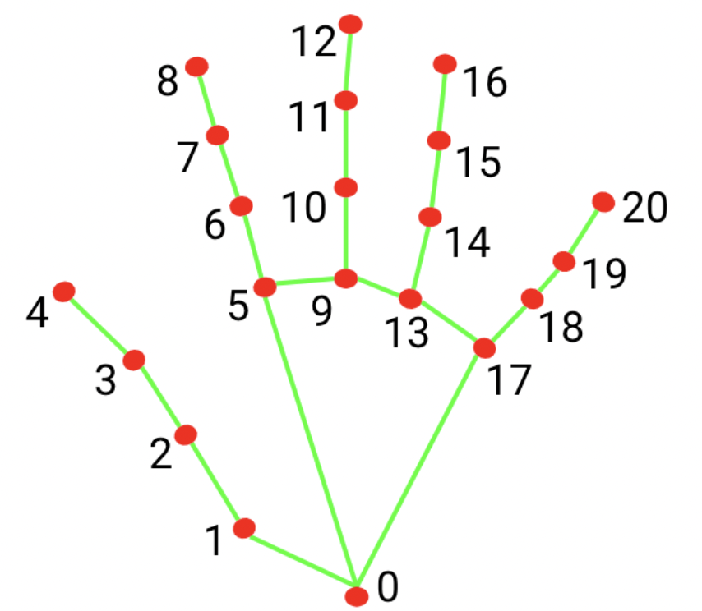
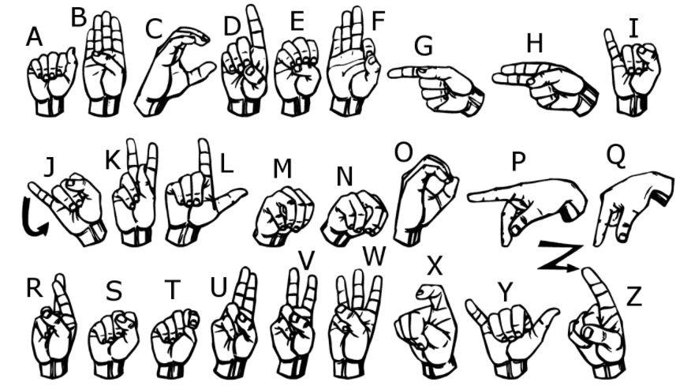
Feature Selection
We chose to use landmarks as features extracted from pictures and video frames using MediaPipe:
X and Y coordinates for 21 landmarks: Total of 42 features
There are 24 classes. We exclude j and z because of motion

Slide 10
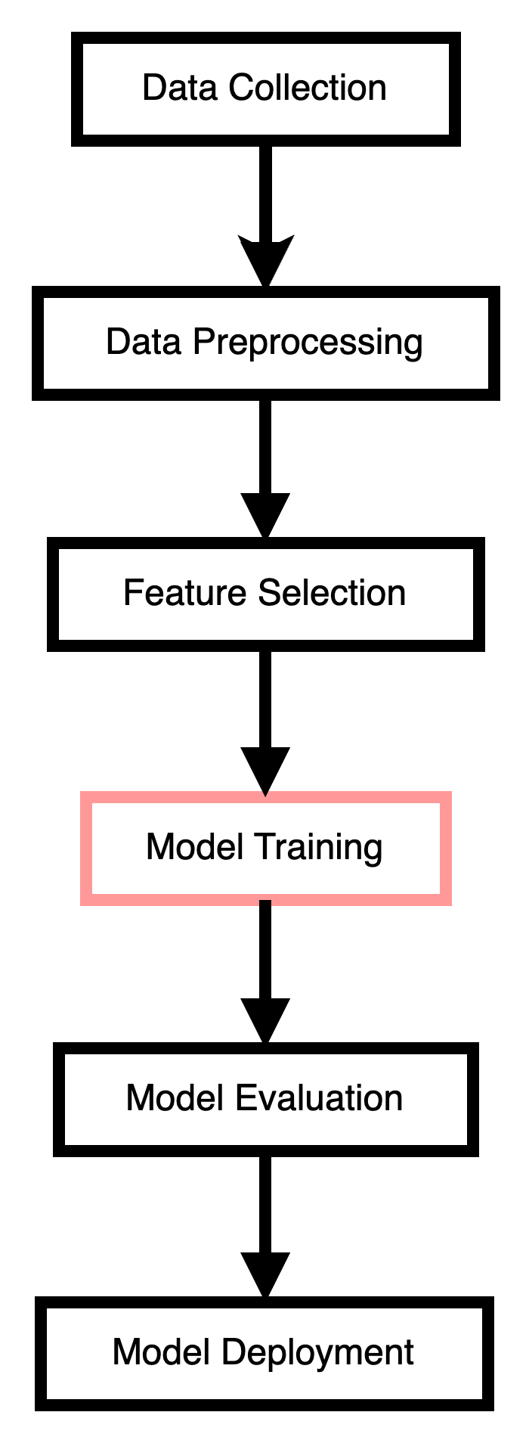
Model Training and Algorithm Choice
Multiclass Classification problem
We explored multiple traditional machine learning algorithms to identify the most suitable one for ASL recognition.
Random Forest
XGBoost
Label encoding
SVM
K-fold cross Validation
Standardized data
The random forest algorithm emerged as our choice due to its strong performance.

Slide 11
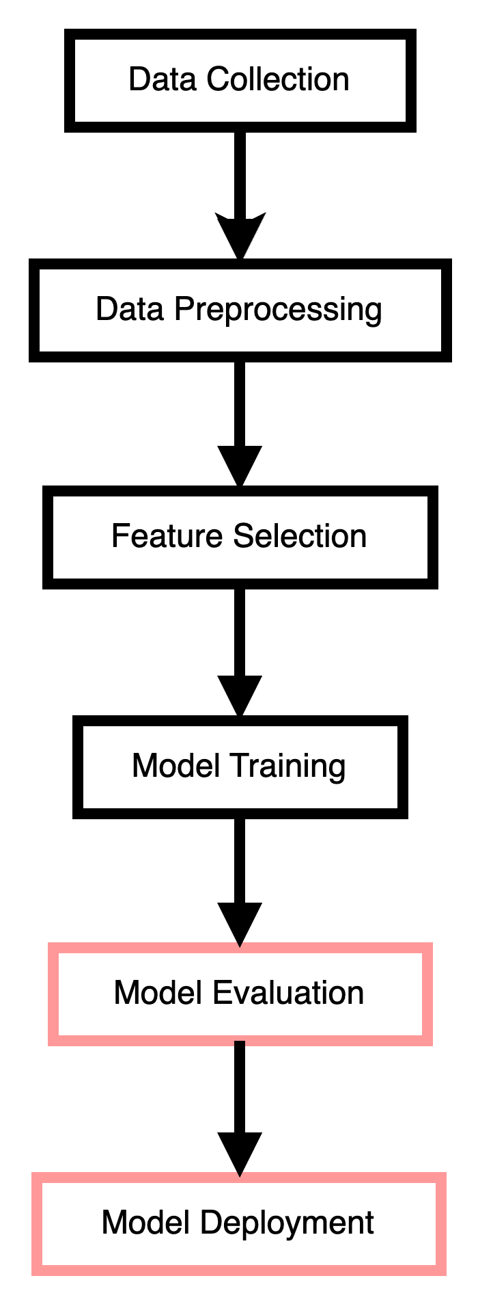
Model Evaluation
Accuracy
Overfitting
Accuracy of Random Forest Classifier: | 97.71
Accuracy of XGB Classifier: | 97.38
Accuracy of SVM Classifier: | 97.41

Slide 12
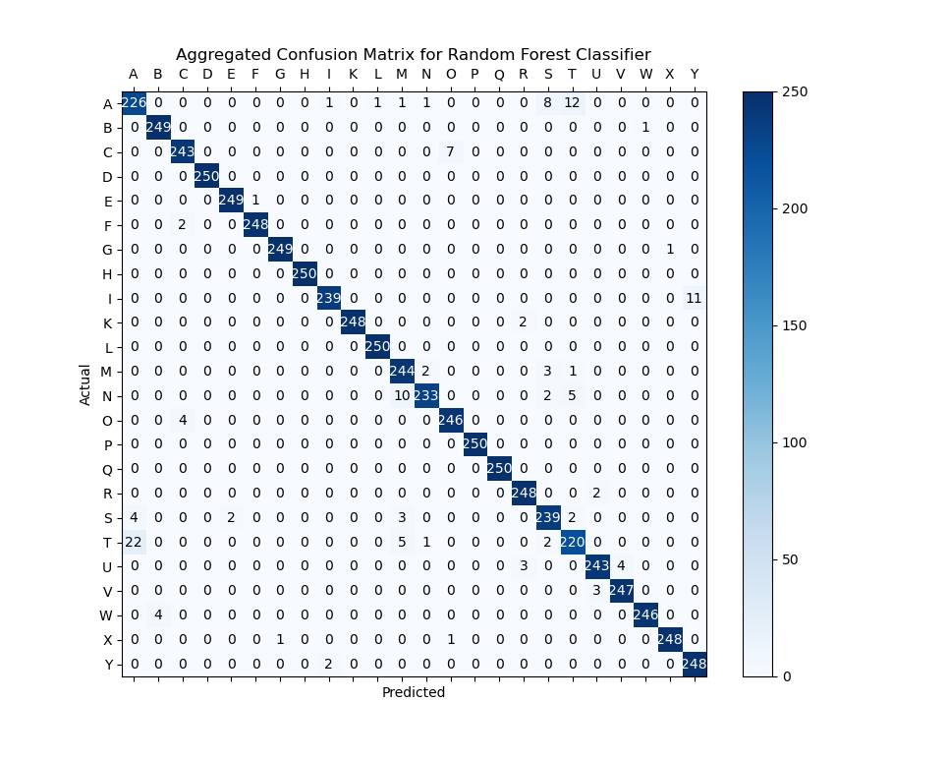
Model Evaluation
Confusion Matrix

Slide 13

Demo

Slide 14
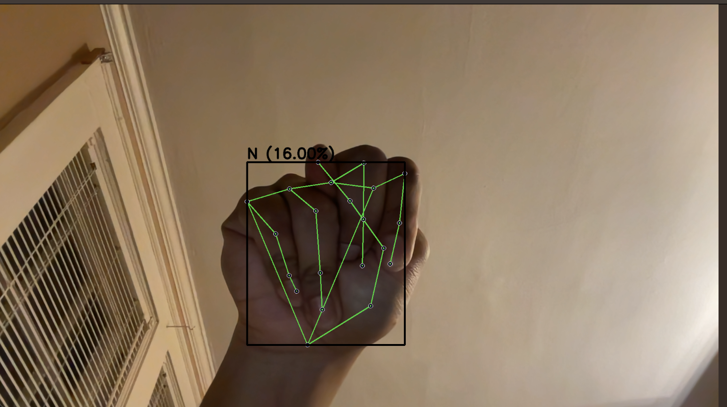
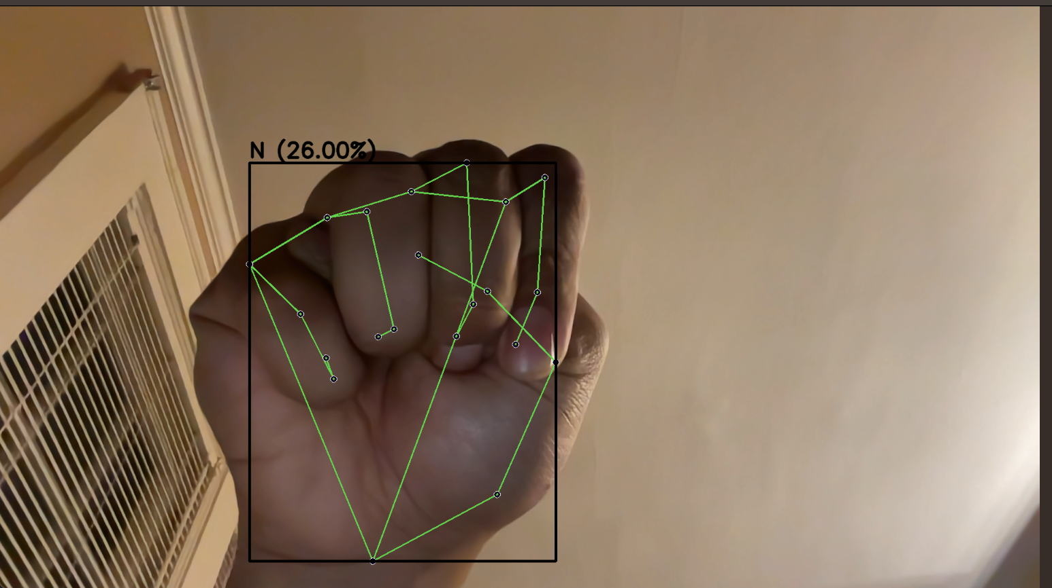
Challenges and Limitations
While our random forest model has shown promise, it has limitations, such as its limited ability to capture spatial dependencies in images.
Limitation between signs of letters
Dark images
N
M

Slide 15
Challenges and Limitations

Slide 16
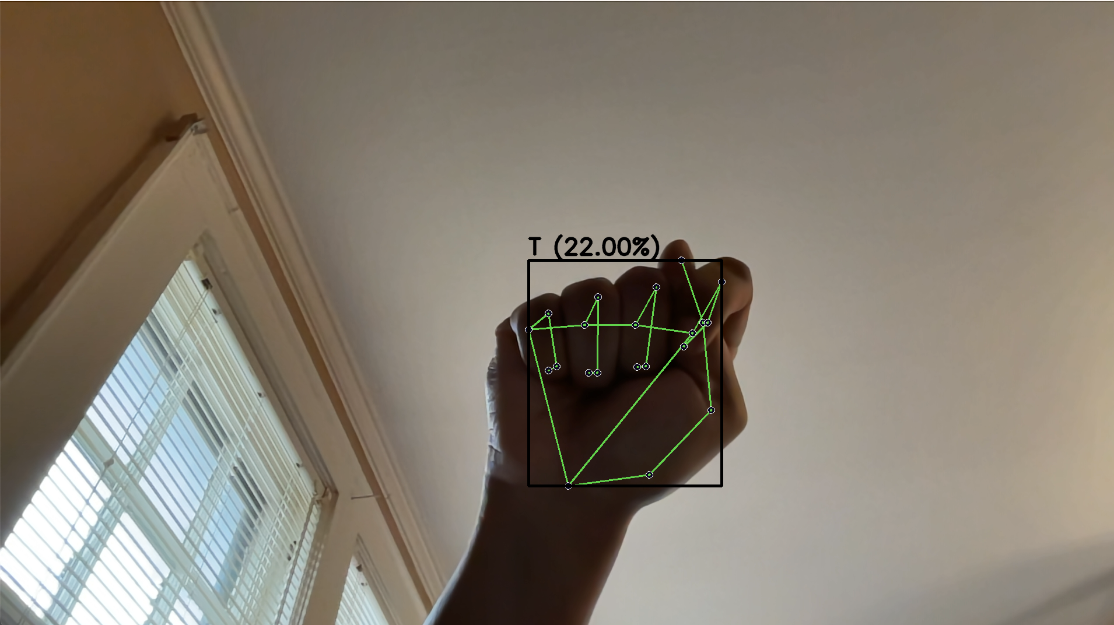
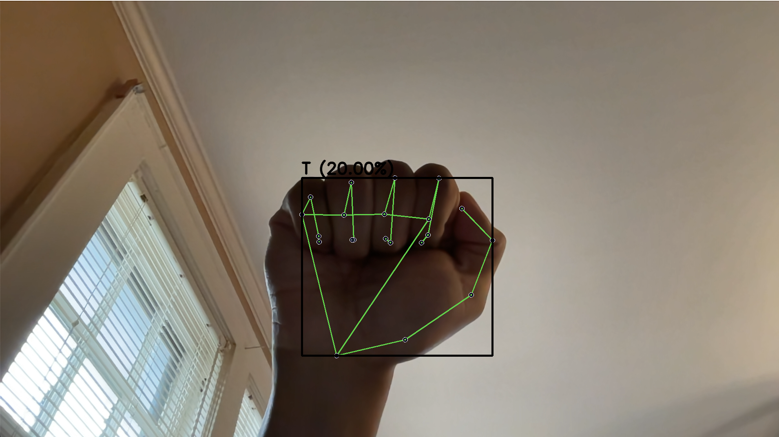
Challenges and Limitations
While our random forest model has shown promise, it has limitations, such as its limited ability to capture spatial dependencies in images.
Limitation between signs of letters
Dark images
T
A

Slide 17
Challenges and Limitations

Slide 18
Future Work and Conclusion
Looking ahead, we plan to increase the training data, add regularization to deal with overfitting and explore convolutional neural networks (CNNs) to further enhance the accuracy and robustness of our ASL recognition system with and without landmarks
S. Kim, Y. Ji and K. -B. Lee, "An Effective Sign Language Learning with Object Detection Based ROI Segmentation," 2018 Second IEEE International Conference on Robotic Computing (IRC), Laguna Hills, CA, USA, 2018, pp. 330-333, doi: 10.1109/IRC.2018.00069.
ROI
CNN

Slide 19
Thank you !
References:
V. Chunduru, M. Roy, D. R. N. S and R. G. Chittawadigi, "Hand Tracking in 3D Space using MediaPipe and PnP Method for Intuitive Control of Virtual Globe," 2021 IEEE 9th Region 10 Humanitarian Technology Conference (R10-HTC), Bangalore, India, 2021, pp. 1-6, doi: 10.1109/R10-HTC53172.2021.9641587
Lugaresi, C., Tang, J., Nash, H., McClanahan, C., Uboweja, E., Hays, M., Zhang, F., Chang, C.L., Yong, M.G., Lee, J. and Chang, W.T., 2019. Mediapipe: A framework for building perception pipelines. arXiv preprint arXiv:1906.08172.
Shin J, Matsuoka A, Hasan MAM, Srizon AY. American Sign Language Alphabet Recognition by Extracting Feature from Hand Pose Estimation. Sensors (Basel). 2021 Aug 31;21(17):5856. doi: 10.3390/s21175856. PMID: 34502747; PMCID: PMC8434249.
I.A. Adeyanju, O.O. Bello, M.A. Adegboye, Machine learning methods for sign language recognition: A critical review and analysis, Intelligent Systems with Applications, Volume 12, 2021, 200056, ISSN 2667-3053, https://doi.org/10.1016/j.iswa.2021.200056.
https://youtu.be/MJCSjXepaAM?si=AIHC6gAvC9aA6fc1

